Slide 1
W209 Final Presentation
WASH Project
Team Members: I-Wae Niu, Chloe Wu, Adara Liao, Elle Proust

Slide 2

Overall Project Objectives
Why is WASH important?
In 2015, 1 in 3 people were without sanitation facilities. In 2016, 1.9M deaths could have been prevented with adequate WASH.
3 interdependent core issues that UNICEF has identified as part of Sustainable Development Goal by 2030
2 Goals
General information on WASH
Tool to prioritize NGO investments
Notes:
In 2015 the World Health Organization (WHO) estimated that "1 in 3 people, or 2.4 billion, are still without sanitation facilities" while 663 million people still lack access to safe and clean drinking water.

Slide 3
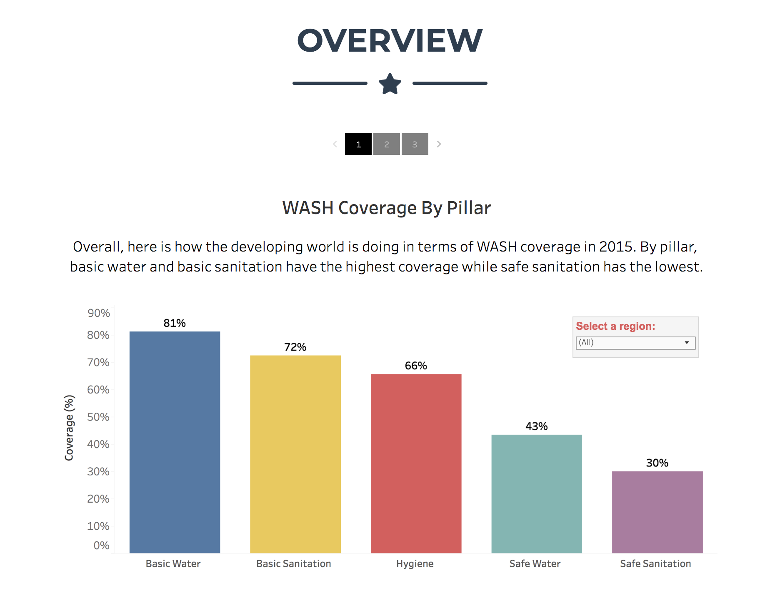
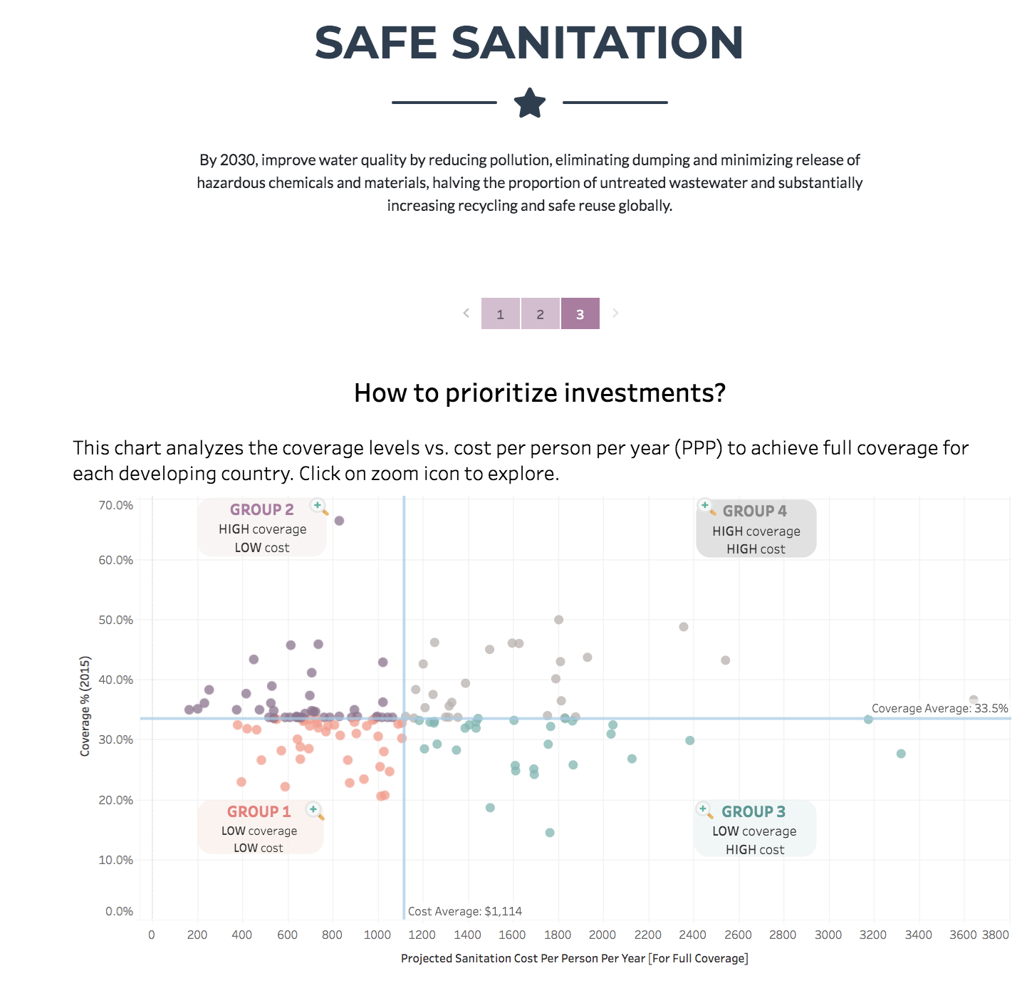
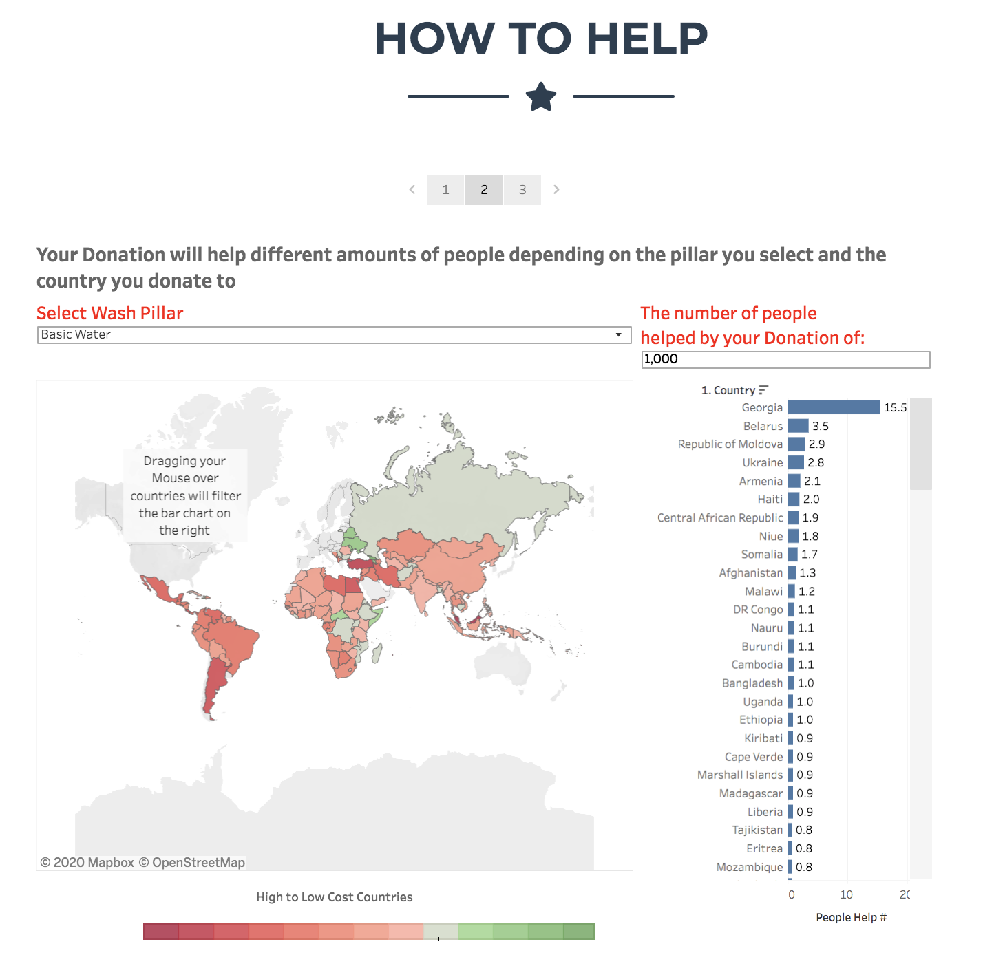


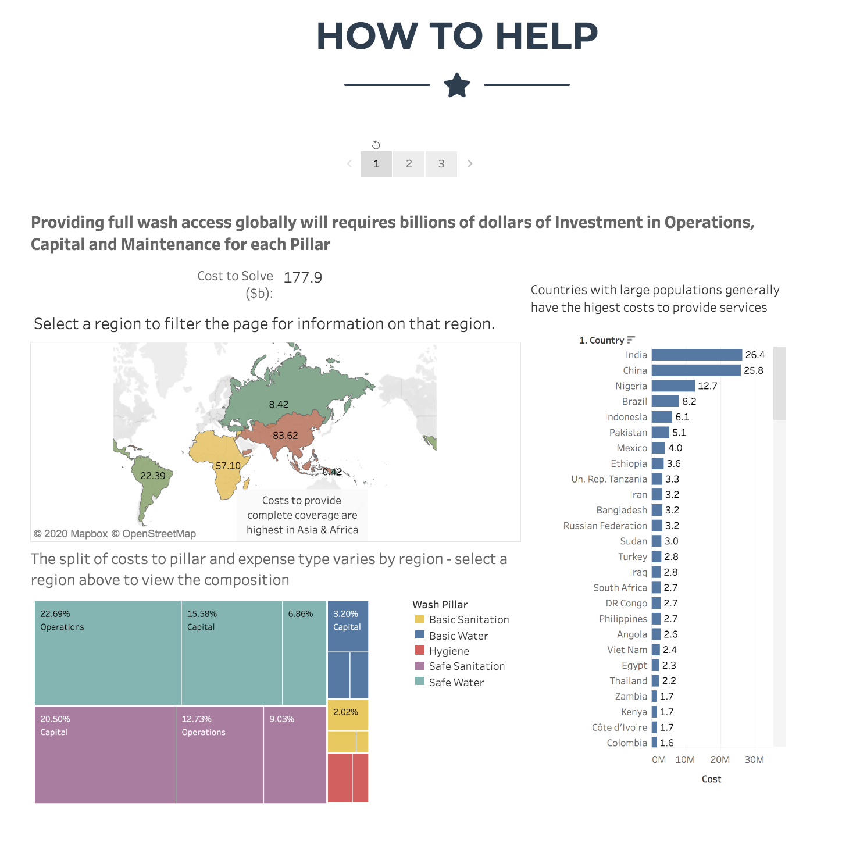
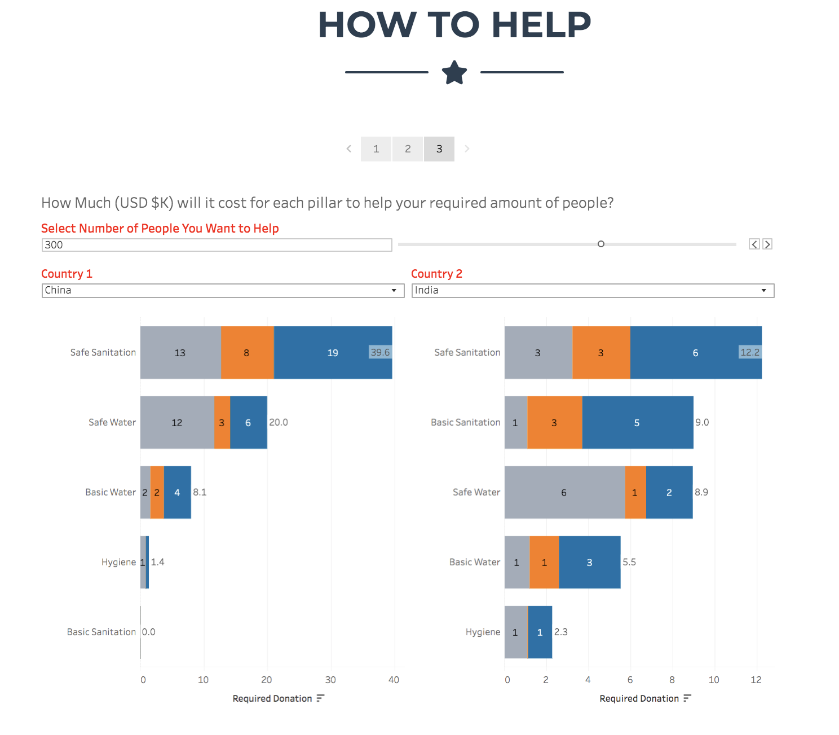
Visualization Roadmap
What is WASH?
What’s the gap?
Cost to solve?
How to invest?
Audience
General public
General public
Gov’t/policy makers
NGOs/donors
Gov’t/policy makers
NGOs/donors
Gov’t/policy makers
NGOs/donors
Tasks
WASH definition
Sub-pillar definitions
Background/context
Coverage by pillar
No. people affected
Compare/rank at global, region & country
Cost to solve total WASH & by pillar
Compare/rank at global, region & country
No. people impacted per $X donated
Compare/rank at global, region & country
Overview
Pillars
How to Help
Intro
Pillars
How to Help

Slide 4
Major MoSCoW Items
Problem
Solution
M
Storytelling - story lost in details, terminology
Navigation - story point navigation confusing
Complexity - too much details, too many tabs
Distill key messages, simplify terminology
Change caption box navigation
Reduce details and # of visuals
S
Interactivity - drill downs/ filters not visible
Design & interpretation - data encodings and function of user input fields unclear
Highlight drill downs/filters and add annotation/instructions
Redesign Where to Invest and How to Help sections to improve interpretation
C
Performance - visuals and headlines cut off
Storytelling - missing real people pictures
Optimize dashboard display formats for auto sizing
Add some pictures to pillar stories
W
Performance - Tableau public link slow to load
N/A

Slide 5
Website Demo
Notes:
Final website: http://groups.ischool.berkeley.edu/WASH_2030/
Test website: http://people.ischool.berkeley.edu/~elleproust/

Slide 6
Demo
I-Wae - Overview + Very high level MoSCoW areas
Adara: Story - pre-testing iteration (Fecal sludge) → Point out detailed MoSCoW items
Chloe - Story - post-testing iteration (Fecal)
Elle - How to help

Slide 7
Internal notes: Pre-testing issues (Adara) - Fecal sludge/safe sanitation (1 of 2)
This is the old website to show this is basis for user testing
Help reader understand concepts through consistent terminology: overview said pillars, after which we said story
We defaulted to original name of field in data source, industry terms and unwieldy like fecal sludge, fixed point defecation, handwashing station
Storytelling: wordiness and confusing terms
Slow load speed user attention, adds to confusing when disjointed images or words load first
Improve navigation
Prompt audience to navigate a new platform: overwhelming to see a lot of text in grey box, not intuitive to user that they should click on the next grey box to advance
Some pillars had 5 or 6 grey boxes, too long and not concise messaging

Slide 8
Internal notes: Pre-testing issues (Adara) - Fecal sludge (2 of 2)
Hard for user to interpret graphs
Not sure difference between top and bottom graphs since both are regions, no more details
Inconsistent metric in one section: top is coverage, bottom is opposite of coverage, and switched to # of people
Axis titles should be pithy and immediately understood
Help user understand meanings:
GDP vs. cost relationship charts difficult to read and interpret; confused on differences between the 4 scatterplots
Tester needed help to understand what is ‘return on investment’
Hard to see which section is what we defined as ‘greatest return on investment’
Show simple metrics where possible, do not divide into rural vs urban for coverage or cost and not show why. The bar charts divide capital and operation spending into rural and urban, so some hand calculation is needed.

